Slide 1

CREDIT CARD FRAUD DETECTION BY USING RANDOM FOREST CLASSIFIER
SIR C R REDDY COLLEGE OF ENGINEERING
DEPARTMENT OF COMPUTER SCIENCE & ENGINEERING
Approved by AICTE, permanently affiliated to JNTU, Kakinada
Accredited by NBA
Eluru, Andhra Pradesh
A.Y-2023-2024

Slide 2
CONTENTS:-
ABSTRACT
LITERATURE REVIEW
EXISTING SYSTEM AND IT’S DISADVANTAGES
PROPOSED SYSTEM
REQUIREMENT SPECIFICATIONS
PROBLEM STATEMENT
DETAILS OF MODULES
SYSTEM ARCHITECTURE AND UML REPRESENTATIONS
ALGORITHM
OUTPUT SCREENS
CONCLUSION
FUTURE ENHANCEMENT

Slide 3
ABSTRACT:-
The project is mainly focused on credit card fraud detection in real world.
Here the credit card fraud detection is based on fraudulent transactions. Generally credit card fraud activities can happen in both online and offline.
But in today's world online fraud transaction activities are increasing day by day. So in order to find the online fraud transactions various methods have been used in existing system.
In proposed system we use Random Forest Algorithm(RFA) for finding the fraudulent transactions and the accuracy of those transactions. After classification of dataset a confusion matrix is obtained.
The performance of Random Forest Algorithm is evaluated based on the confusion matrix. The results obtained from processing the dataset gives accuracy of about 98%.

Slide 4
LITERATURE REVIEW:-
Fraudulent Detection in Credit Card System Using SVM & Decision Tree:
Authors: Vijayshree B. Nipane, Poonam S. Kalinge, Dipali Vidhate, Kunal War, Bhagyashree P. Deshpande
Methodology: Utilizes decision tree, genetic algorithm, neural network, and Support Vector Machine (SVM) to detect credit card fraud. Focuses on reducing financial losses through hybrid approach implementation.
Detecting Credit Card Fraud by Decision Trees and Support Vector Machines:
Authors: Y. Sahin and E. Duman
Approach: Develops classification models based on decision trees and support vector machines (SVM) for credit card fraud detection. Compares the performance of these methods using real data.

Slide 5
EXISTING SYSTEM:-
In the existing system there are lot of machine learning approaches implemented for detecting credit card fraud detection which are implemented based on Logistic regression and K- Means and SVM which are giving 94℅,53%,70% accuracy respectively.
In this project we are trying to improve the accuracy by refining the data in a better way for efficient detection of credit card fraud.
DISADVANTAGES:-
K-means produce less accurate scores in prediction in this kind of scenarios.
This is not accurate for large dimensional dataset.
This is accurate if we use for less dimensions

Slide 6
PROPOSED SYSTEM:-
a) In proposed System, we are applying random forest algorithm for classify the credit card dataset. Random Forest is an algorithm for classification and regression
b) Random forest has advantage over decision tree as it corrects the habit of over fitting to their training set.
c) A subset of the training set is sampled randomly so that to train each individual tree and then a decision tree is built, each node then splits on a feature selected from a random subset of the full feature set.
d) The Random Forest algorithm has been found to provide a good estimate of the generalization error and to be resistant to overfitting.
ADVANTAGES:
1. Random forest ranks the importance of variables in a regression or classification. problem in a natural way can be done by Random Forest.
2. The amount' feature is the transaction amount. Feature 'class' is the target class for the binary classification and it takes value 1 for positive case (fraud) and 0 for negative case (non fraud).

Slide 7
REQUIREMENT SPECIFICATIONS :-
HARDWARE REQUIREMENTS:-
Processor - Intel
RAM - 4 Gb
Hard Disk - 260 GB
SOFTWARE REQUIREMENTS:-
Python
Anaconda
OS - Windows 7, 8 and 10 (32 and 64 bit)

Slide 8

PROBLEM STATEMENT :-
Credit card fraud is a significant concern for both financial institutions and cardholders. Detecting fraudulent transactions in real-time is crucial to prevent financial losses and maintain customer trust.
In this project, we aim to develop a machine learning model using the Random Forest classifier to accurately detect fraudulent credit card transactions.

Slide 9
DETAILS OF MODULES:-
DATA COLLECTION
DATA PRE-PROCESSING
FEATURE SELECTION
TRAIN/TEST SPLIT
MODEL TRAINING
MODEL EVALUATION

Slide 10
1.Data Collection:
In this module we try to load the dataset which is collected from Kaggle website and then try to give that excel file information as input to the next module. Dataset URL: https://www.kaggle.com/mlg-ulb/creditcardfrau To provide privacy to user’s transaction data kaggle peoples have converted transaction data to numerical format using PCA Algorithm.
2. Data Pre-processing:
The collected data needs to be cleaned and preprocessed before applying the algorithm. This involves handling missing data, outliers, and transforming categorical variables into numerical variables.
3. Feature Selection:
Select the most relevant features that contribute to the classification of fraudulent transactions. This step can be done by using statistical tests, correlation analysis, or domain knowledge.

Slide 11
4. Train/Test Split:
Here we try to divide the data into test and train datasets and we used 70: 30 percent ratio for dividing the whole dataset into multiple parts. Here 70 percent data records are used for training the system and 30 percent data is used for testing the model.
5. Model Training:
Here we try to run the RF algorithm on the train dataset and try to check the probability of each and every attribute which is present in that record. Once all the records are processed now, we try to find out which records are having fraud activity and which are having normal activities. we use RF on training dataset, we can get accuracy of nearly 99.7 percent which is very high compared with several primitive algorithms.
6. Model Evaluation:
Evaluate the performance of the Random Forest model on the testing set. This involves computing metrics such as accuracy, precision, recall, F1 score.

Slide 12
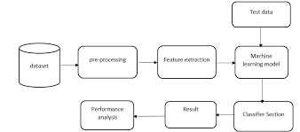
SYSTEM ARCHITECTURE:-
System Architecture diagrams helps developers and system designers to outline the software and to check whether the software meets their client needs.
There are several steps involved
First the credit card dataset is taken from the source and cleaning and validation is performed on the dataset which includes removal of redundancy, filling empty spaces in columns, converting necessary variable into factors or classes then data is divided into 2 part, one is training dataset and another one is test data set. However, the data which is preprocessed is further treated using a random forest algorithm in two ways by using the train data set and then using the test data set. The attained results are verified as legal and fraudulent transaction process.

Slide 13
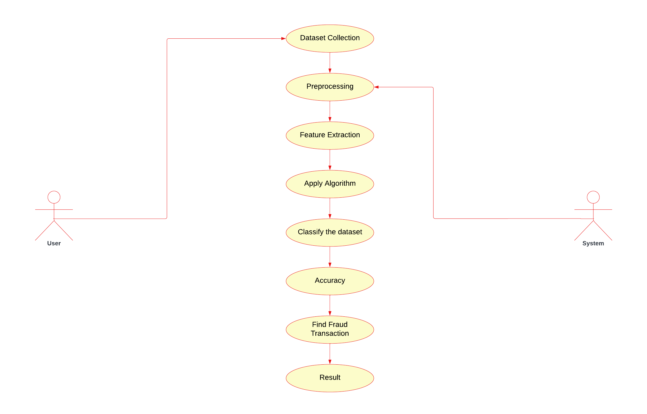
UML REPRESENTATIONS:-
USE CASE DIAGRAM:-
The user doesn't directly interact with the system in this use case diagram. The system goes through a series of steps to identify fraudulent transactions:
Dataset Collection: Collects data on credit card transactions.
Preprocessing: Cleans and prepares the data for analysis.
Feature Extraction: Extracts relevant features from the data that can be used to identify fraud.
Apply Algorithm: Applies a machine learning algorithm to the data to classify transactions as fraudulent or legitimate..

Slide 14
USE CASE DIAGRAM:-
Classify the Dataset: Classifies the dataset based on the applied algorithm.
Accuracy: Evaluates the accuracy of the classification.
Find Fraud Transaction: Identifies transactions classified as fraudulent.
Result: Outputs the results, likely a list of fraudulent transactions.

Slide 15
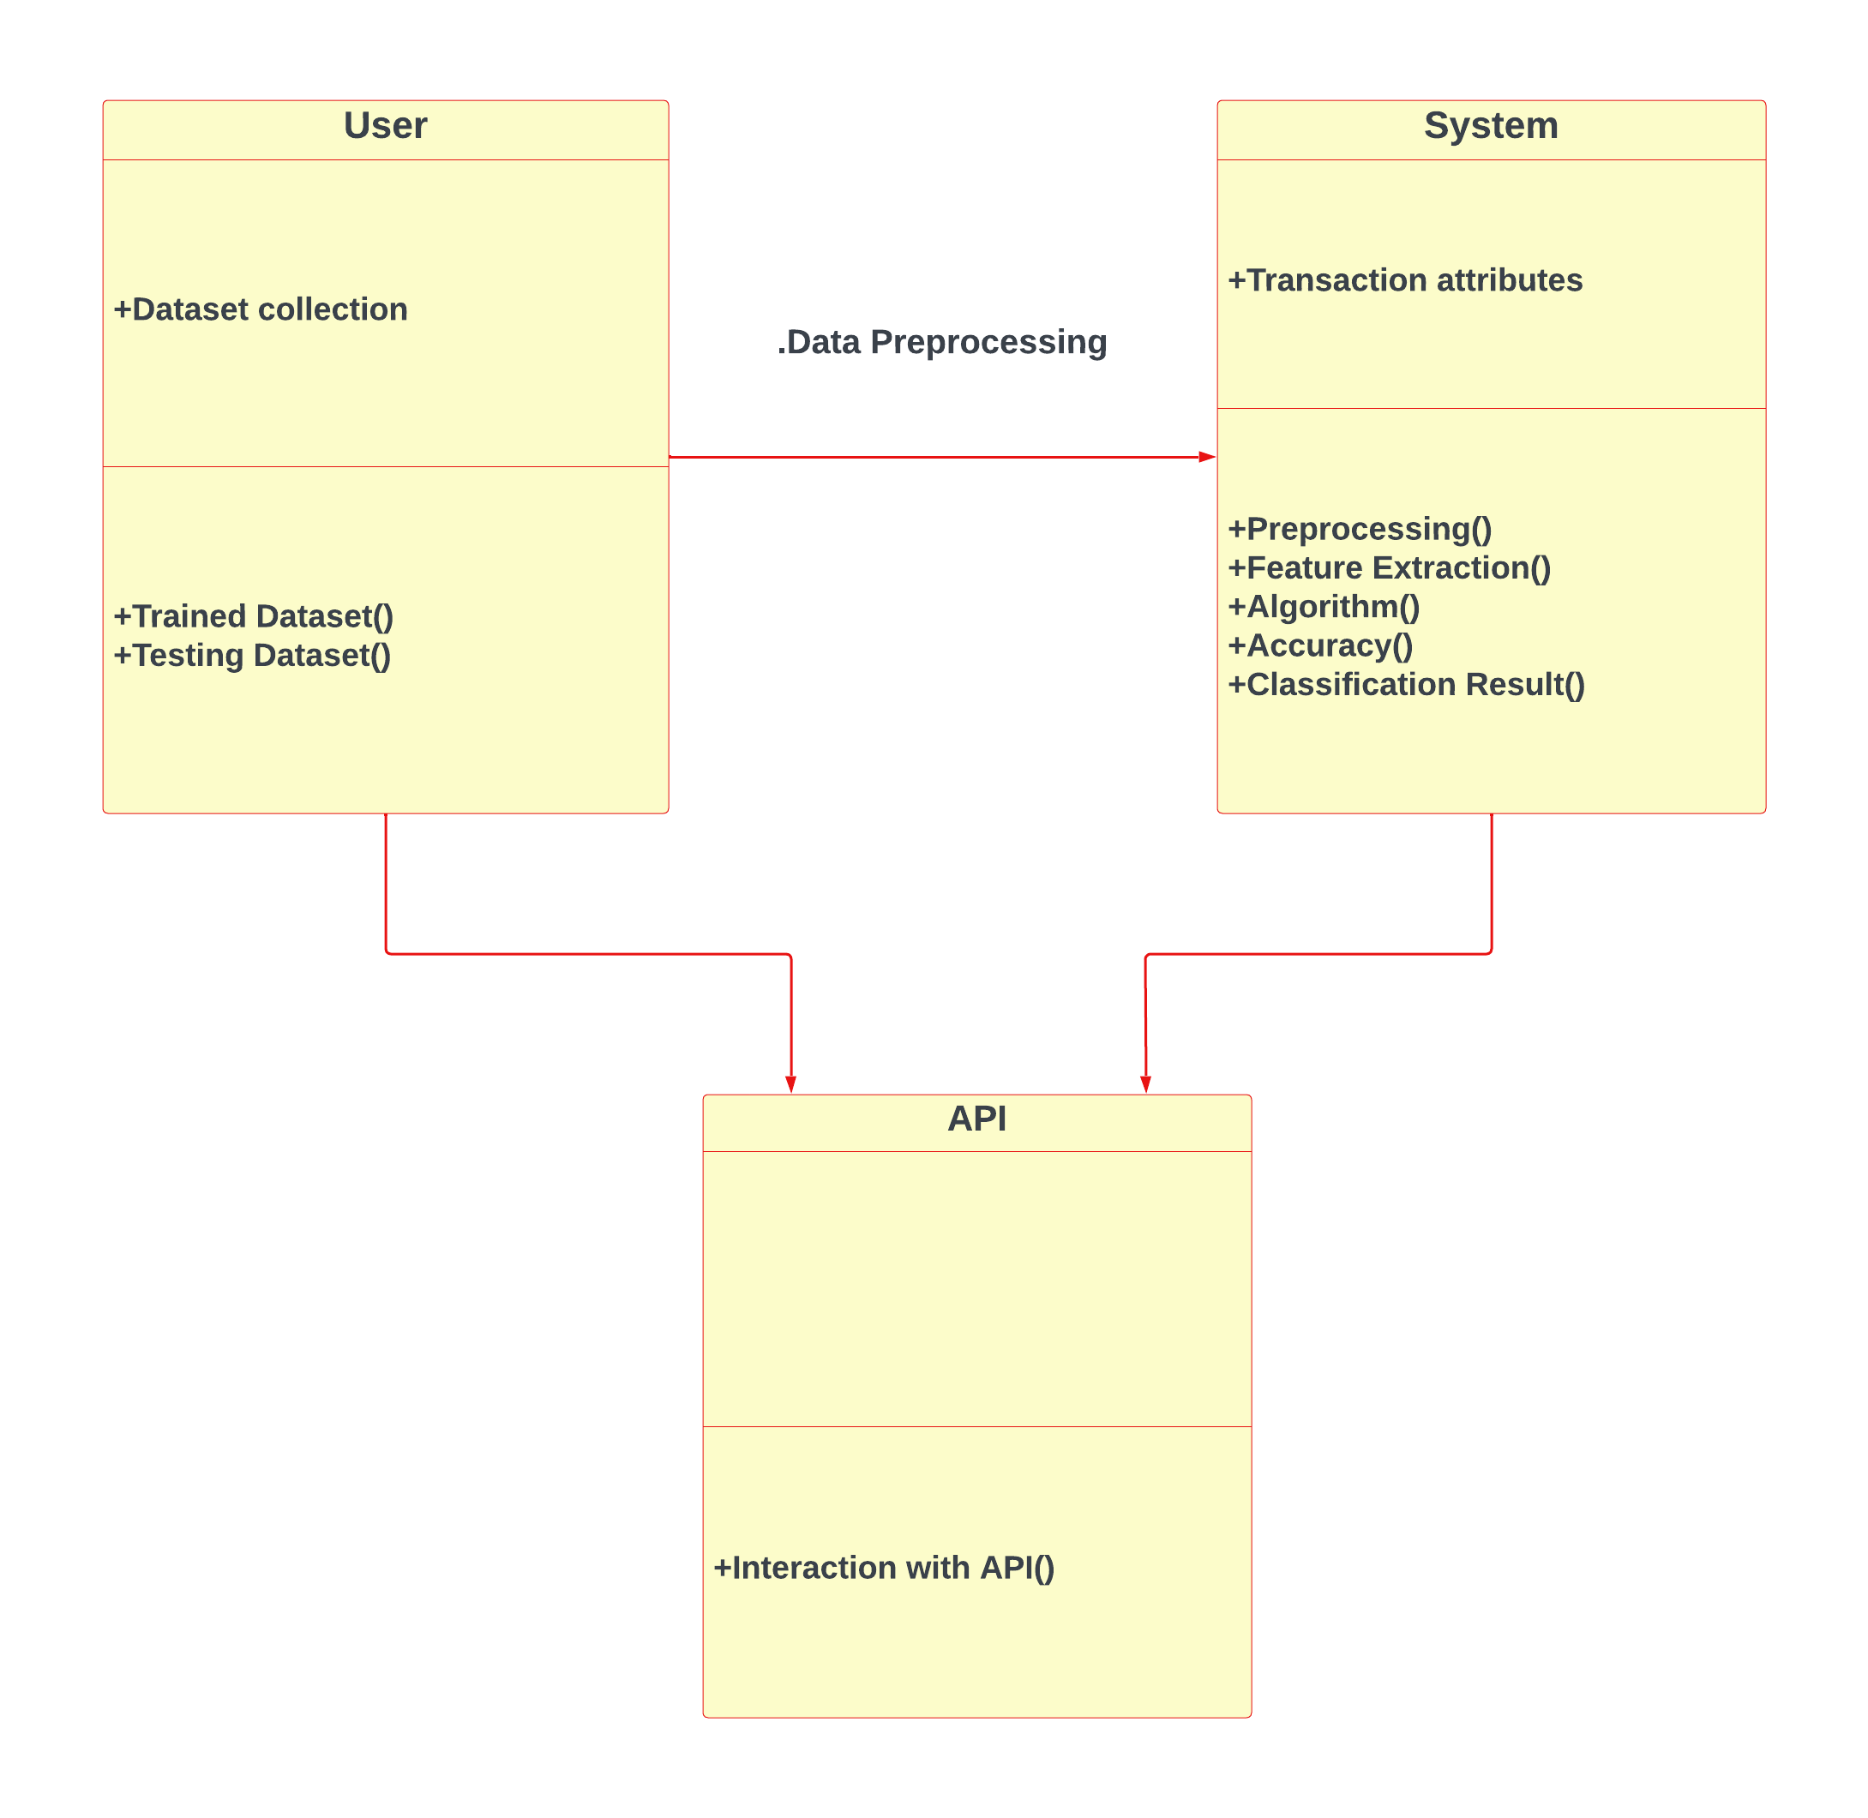
UML REPRESENTATIONS:-
CLASS DIAGRAM:
User: This class represents the user who interacts with the system. It likely has responsibilities for collecting data from the user, such as historical credit card transactions.
System: This class represents the overall credit card fraud detection system. It interacts with other classes to collect, preprocess, train, and evaluate the model for fraud detection.
Data Preprocessing: This class is responsible for cleaning and preparing the raw data for use in the machine learning model. This may involve handling missing values, scaling numerical features, and encoding categorical features.
API: This class represents an interface (API) that the system uses to interact with external systems. This could be used to retrieve data from a credit card company's database or to send alerts about potential fraud.

Slide 16
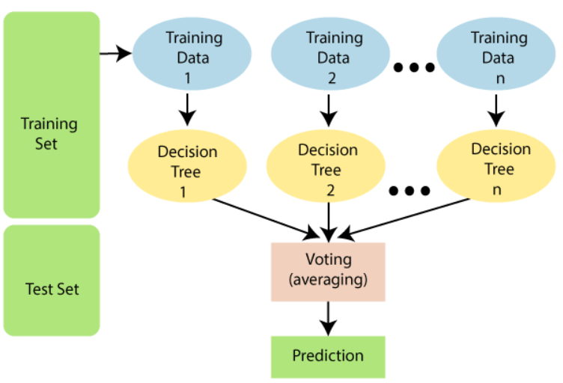
ALGORITHM :-
Random Forest:
Random forest is a type of supervised machine learning algorithm based on ensemble learning.
Ensemble learning is a type of learning where you join different types of algorithms or same algorithm multiple times to form a more powerful prediction model.
The following are the basic steps involved in performing the random forest algorithm
Pick N random records from the dataset.
Build a decision tree based on these N records.
Choose the number of trees you want in your algorithm and repeat steps 1 and 2.
For classification problem, each tree in the forest predicts the category to which the new record belongs. Finally, the new record is assigned to the category that wins the majority vote.

Slide 17
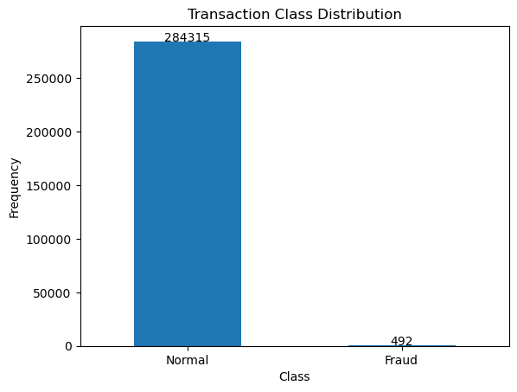
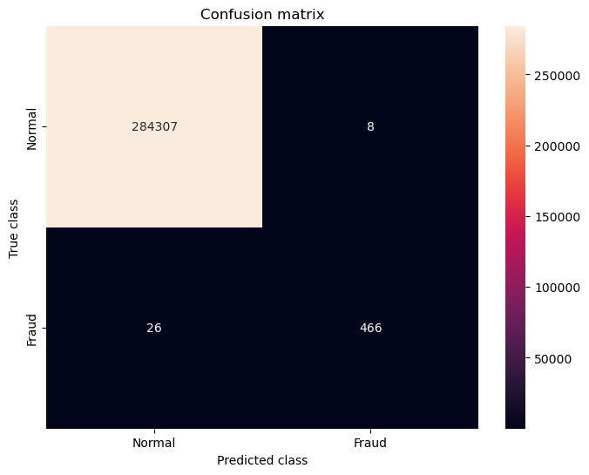
OUTPUT SCREENS:-

Slide 18
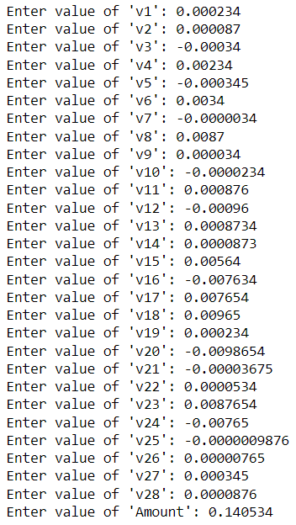
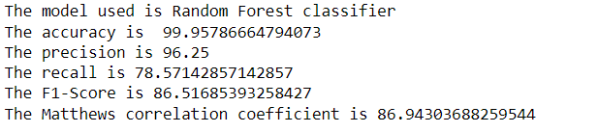

OUTPUT SCREENS:-

Slide 19
CONCLUSION:-
Thus, through this project, credit card fraud transactions are detected by employing relevant machine learning algorithms. The algorithm efficiency is determined by Calculating the accuracy score and showing in the form of confusion matrix. Machine Learning models are trained in such a way that various types of frauds can be detected and prevented in future. Various features are extracted from the dataset and frauds are analyzed from various perspectives and the models are trained using the extracted features to get the desired output.

Slide 20
FUTURE ENHANCEMENT:-
The project can be further enhanced where instead of Random Forest Algorithm, some other algorithms can be employed in order to predict the credit-card frauds. Performance of the algorithms can compare in terms of time and accuracy rate. Some more features can Be added in addition to the existing features in order to improve the efficiency of the Overall system.

Slide 21
THANK YOU…
Team members:
SL.NO. REGD. NO. NAME
1. 20B81A0528 Ch. Lakshmi Prathyusha
2. 20B81A0529 Ch. Tejaswi
3. 20B81A0530 Ch. Manikanta Amareswar
4. 20B81A0531 Ch. Rahul
20B81A0532 Ch. RatnaBabu
Under the Guidance of M S Ekambareesh

